Slide 1
Deep Reinforcement Learning Assignment 1
Instructor: Prof. Chun-Yi Lee (李濬屹)
TA Email: drl-elsalab@googlegroups.com

Slide 2
Overview
There are four question in this assignment
Q1~Q3
Complete the code in the colab notebook.
This file provide some sample outputs for these questions.
Q4
To train your own agent and get the higher score.

Slide 3
Q1-Q3
Make a copy of the notebook using File > Save a copy in Drive and edit it with your answers.
Fill in the missing code snippets (marked by TODO).

Slide 4
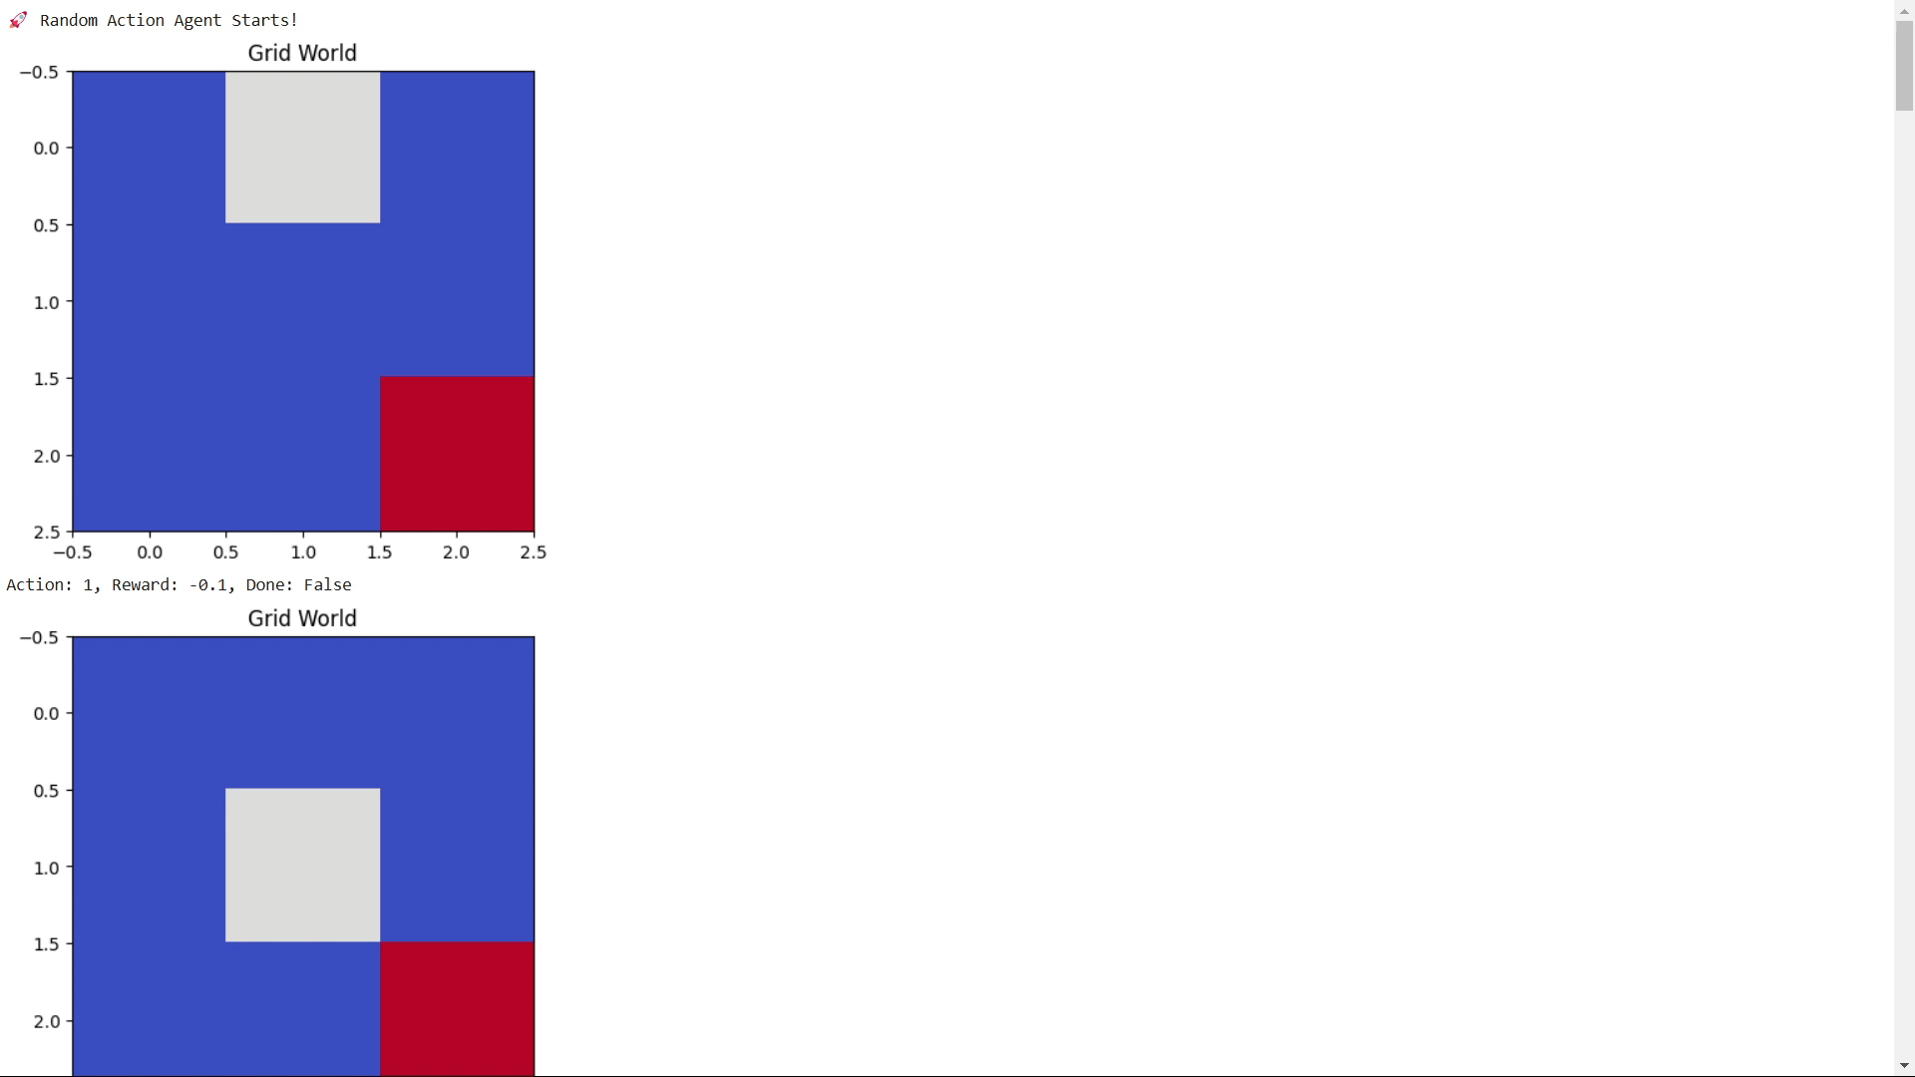
Q1
Implement a grid-world environment by your-self
Do not use any code from gym.
Sample output:

Slide 5
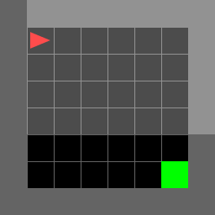
Q1
Implementing a Random Agent in MiniGrid
env = gym.make("MiniGrid-Empty-8x8-v0")
Sample output:

Slide 6
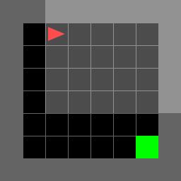
Q1
Implementing a Rule-Based Agent in MiniGrid
Default action: move forward
Randomly turn if facing a wall
Sample output:

Slide 7
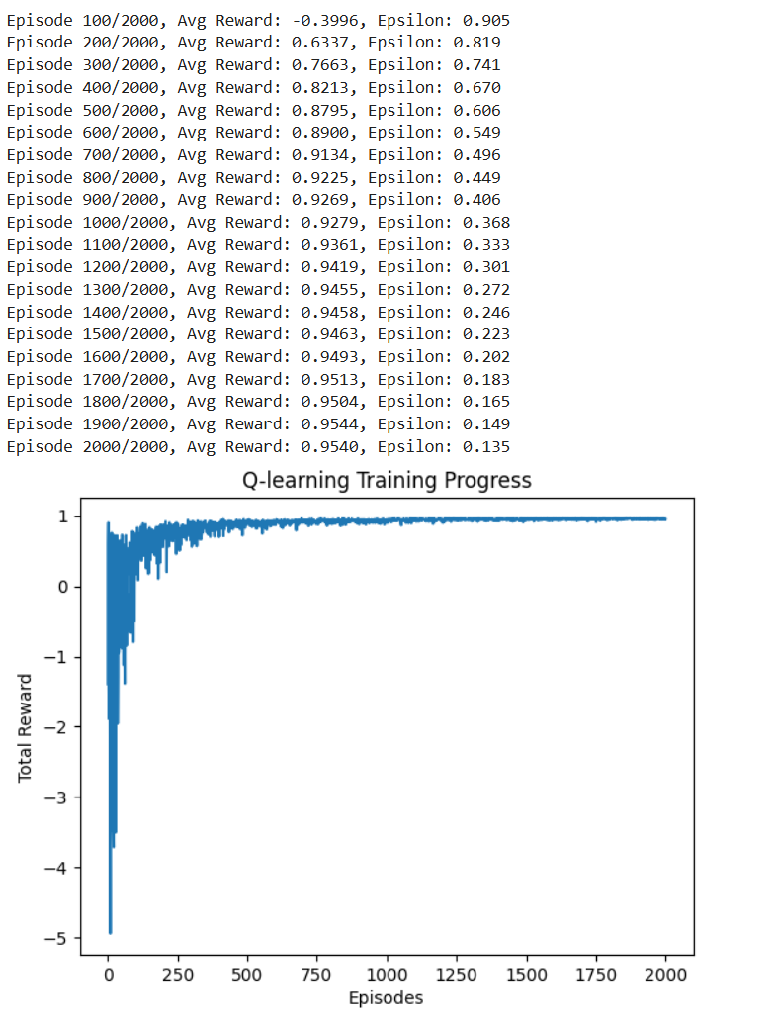
Q2 & Q3
For each training
Sample output:

